Slide 1
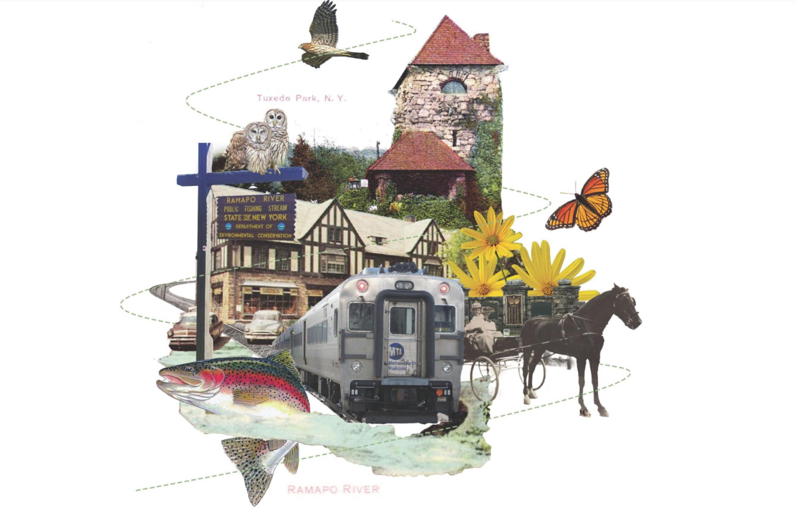

Slide 2
Tuxedo Hamlet Revitalization
Objectives and Transformative Projects
--Economic Development and Business Development
--Connectivity and Pedestrian Walkways
--Landscaping and Beautification
--Connectivity to Parks and Trails
--Open Space and Community Gathering

Slide 3
Economic Development
Business Opportunities
  The Junction
  The Train Station
  Municipal Parking
  Finalizing LDC Projects
  Orange County and State Resources

Slide 4
Pedestrian Walkways and Connectivity

Slide 5
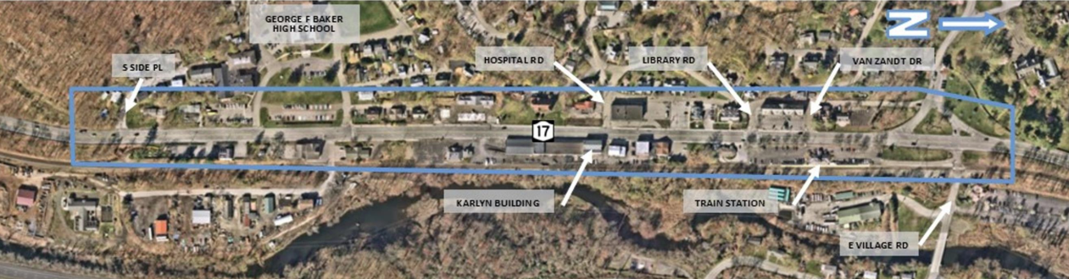

Slide 6
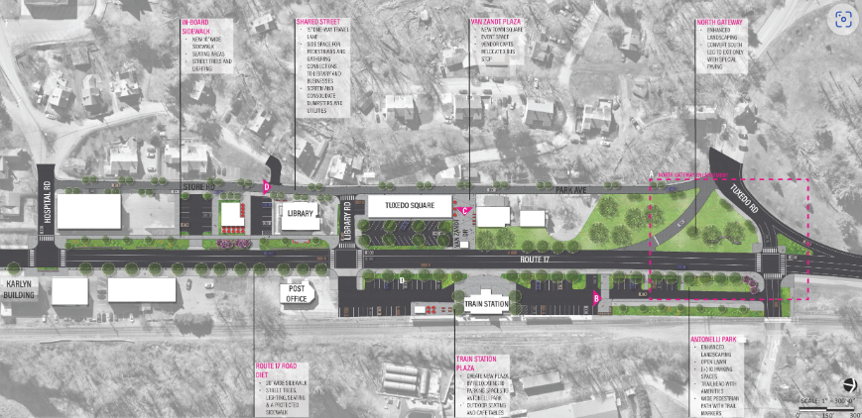

Slide 7
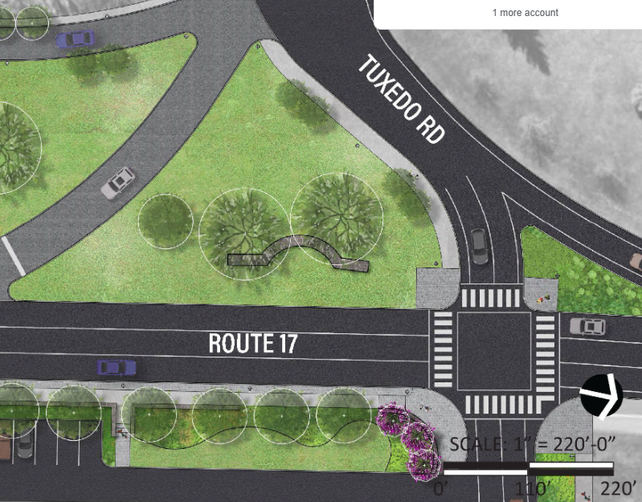

Slide 8
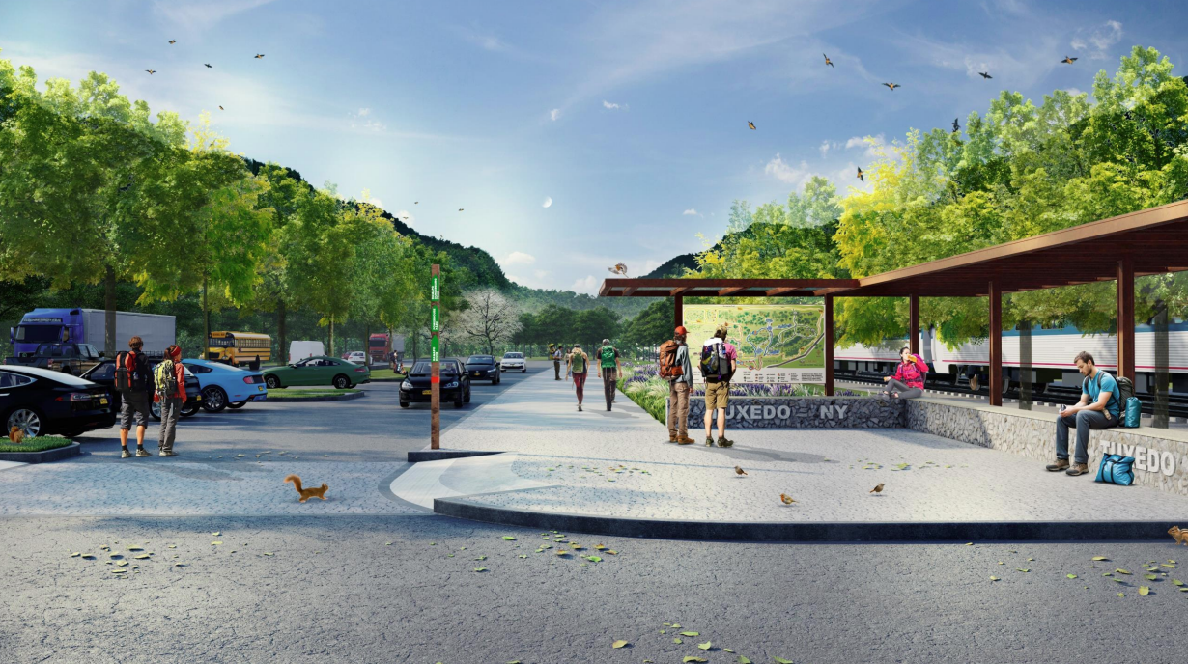

Slide 9
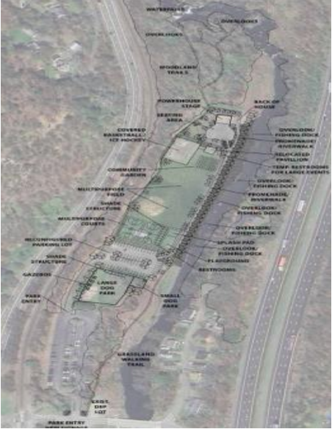
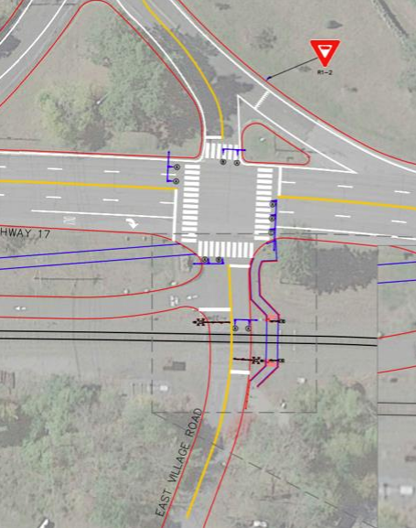

Slide 10
